Slide 1
Redesigning Orientation with CalWORKs 2.0 in Mind Webinar #12
October 24, 2018 @ 2:00–3:00 p.m. PT
Facilitated by:
LaDonna Pavetti, Center on Budget and Policy Priorities
Val Uccellani, Global Learning Partners
Notes:
Brian

Slide 2
Expand Event Windows
To expand event windows, click the button on the top right corner of the slide deck window.
To adjust the slide size, drag the bottom right corner of the window.
To expand event windows, click the button on the top right corner of the slide deck window.
To adjust the slide size, drag the bottom right corner of the window.

Slide 3
Event Materials and Recording
The event recording will be available approximately 1 day after the webcast and can be accessed using the same audience link used for the live webcast.
The recording will also be posted to the website.
To download the slide deck and materials for this presentation, click the “Resource List” widget at the bottom of your screen.

Slide 4
Q&A
To pose a question or share a comment with the presenters at any time, click on the “Q&A” widget at the bottom and submit your question.
Please note, your questions can only be seen by our presentation team and are not viewable by other attendees.
Notes:
We will use this space for comments and ideas also. Explain that you will also see a pop up occasionally with responses to your colleagues questions or comments.
VU (and Lindsay?) will monitor Q & A during this webinar

Slide 5
Technical Assistance
If you are experiencing technical difficulties, please visit our Webcast Help Guide by clicking on the “Help” widget below the presentation window.
You can also click on the Q&A widget to submit technical questions.
Notes:
? = help? Vs. Q&A widget?

Slide 6
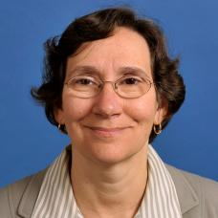
Facilitators
LaDonna Pavetti
Center on Budget and Policy Priorities
Val Uccellani
Global Learning Partners

Slide 7
Webinar Objectives
During today’s webinar, you are invited to:
Examine a framework for redesigning orientation (with CalWORKs 2.0 in mind)
Explore tips for designing and facilitating a reimagined orientation
Review a sample flow for a reimagined orientation
Decide on one next step you (or your team) want to take to fortify your own orientation with CalWORKs 2.0 in mind
Notes:
Val kick off slides 7,8

Slide 8
Webinar Objectives
This webinar has four parts. We will pause after each for you to reflect and move toward action.
Feel free to ask a question or make a comment at any time using the Q&A button!
Notes:
Val note: Time won’t allow for us to see or acknowledge all that you type into the QA during the hour – but we will definitely review it and “feed” it into the orientation guide that we are finalizing – to be shared statewide soon.

Slide 9
Part 1: Framework for
Redesigning Orientation
Notes:
2:05 – Donna do Part I
End 2:15

Slide 10
A Framework to Reimagine Orientation
Orientation is often clients’ first introduction to CalWORKs. How can we use orientation to accomplish the following?
Create a supportive relationship (with the program and with staff)
Reduce sources of stress
Build skills – and move participants toward action
Notes:
Donna

Slide 11
Create a Supportive Relationship
Inspire clients to think about a better future
Spend time getting to know the participant
Establish a personal connection
Notes:
Donna

Slide 12
Reduce Sources of Stress
Focus on the positive
Provide only necessary information
Allow choice
Notes:
Donna

Slide 13
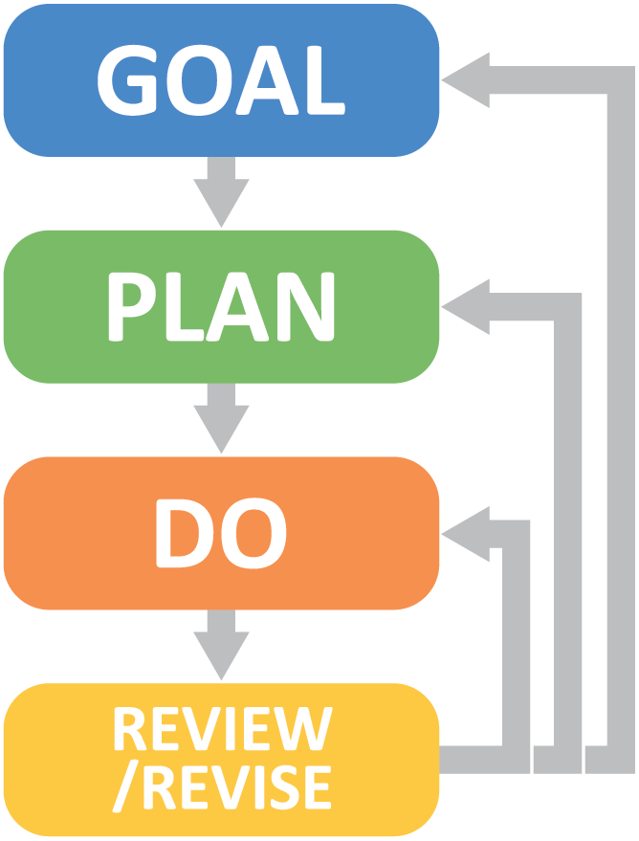
Build Skills
Use the language of goal achievement – and model the process
Connect CalWORKs services to participants’ hopes and dreams
Create an action plan
Notes:
Donna

Slide 14
Move Participants Toward Action
KNOWLEDGE INTENTION ACTION

Slide 15
Part 1: Reflection
In what ways does your current orientation already accomplish the following?
Create a supportive relationship (with the program and with staff)
Reduce sources of stress
Build skills – and move participants toward action
Take a moment to reflect and/or exchange with your colleagues.
Type your thoughts in the Q&A widget.
Notes:
Donna pose question and monitor QA for responses?

Slide 16
Part 2: Orientation (Re)Design and Facilitation Tips
Notes:
2:15 – Val do Part 2
End 2:30

Slide 17
Orientations SHOULD NOT
Contain too much information
Introduce every program staff
Ask participants to complete copious amounts of paperwork
Focus on rules and regulations
Notes:
Val

Slide 18
Orientations SHOULD (Tips 1–4)
Reduce the hassle factor
Convey positive messages
Provide key, high-level information about program services
Explain responsibilities and limits, succinctly
Notes:
Val – see checklist in your packet

Slide 19
Orientations SHOULD (Tips 5–8)
Acknowledge the diversity of participants
Enable clients to tell their story, briefly
Start with the future
Provide concrete, actionable next steps
Notes:
Val

Slide 20
Five (Re)Design Principles
REACH™
Relevant – what matters most right now
Engaging – not just listening, but sharing insights
Actionable – doing something with the content
Clear – using plain language and visuals
Holistic – addressing head, heart, and hands
www.globallearningpartners.com
Notes:
Val - As you are using the checklist to design or re-design, here are 5 proven adult learning principles to keep in mind.

Slide 21
Four Key Facilitation Skills
Listen
Wait
Affirm
Show sincere curiosity
Notes:
Val - The impact of orientation on participants relies not only on how its designed, but how its facilitated. Here are just four key skills that help achieve a strong first experience for participants.

Slide 22
Practical Suggestions for Orientation Facilitators
Assume a listening posture
Make it a conversation among equals
Teach with confidence and credibility
Ask open questions
Refer back frequently to clients’ comments and stories
Notes:
Val

Slide 23
Practical Suggestions for Written and Visual Materials
Use plain language
Use images and words to convey information
If using PowerPoint, use slides to pose questions and reflections
Create simple handouts
Notes:
Val

Slide 24
Part 2: Reflection
Review the Eight Tips for Orientation (Re)design.
Which ONE TIP feels most important for you and your team?
What other tips might you add?
Take a moment to reflect and/or exchange with your colleagues.
Type other tips in the Q&A widget.
Notes:
Val pose question and monitor QA for responses.

Slide 25
Part 3: Example of a Reimagined Orientation
Notes:
2:30 – Donna do Part 3
End 2:45

Slide 26
CalWORKs 2.0 Orientation: Helping You Find and Realize Your Hopes and Dreams
Notes:
This sample orientation offers a suggested, possible FLOW to the orientation event. It can be used for a one-on-one or a group orientation. This sample flow does not include activities for the participants – that's where your creativity comes in!

Slide 27
Guide to Orientation
10:00
Goals and Plans for Orientation
What CalWORKs Can Do For You
11:00
Exploring Your Hopes and Dreams
Getting to Know You
The Path Forward: What’s Next
Mutual Obligations: We’re In This Together
Creating a Plan for Taking the First Step

Slide 28
Looking to the Future: Exploring Your Hopes and Dreams
What do you want MOST in life?
When you picture yourself there, what do you see?
Notes:
How about more relevant (urban/ older) picture?

Slide 29
What CalWORKs Can Do For You
Key features of CalWORKs:
Flexible: Multiple paths that can change over time
Supportive: We offer services to help you succeed on your path
Time limited: There are constraints; want to make the most of your time with us
CalWORKs Paths to Work
Employment
Education /Training
Work Experience
Family Support Services
Support Services (child care, transportation, housing assistance, work supports, etc.)
Notes:
To me this is a weird graphic with person walking two different ways...Might want to pretest it before using.

Slide 30
Getting to Know You
Thinking about your life right now:
What areas are going well?
What would you most like to be different?
Notes:
See suggestion for photos.

Slide 31
The Path Forward: What’s Next?
Job Search Assistance
Family Support
Education/Training
Exempt

Slide 32
Mutual Obligations: We’re in This Together
CalWORKs has rules that we’re here to help you meet:
Follow through with appointments
Participate in and document your activities
48-month time limit (with more options in the first 24)
Communicate your needs – if something isn’t working, tell us!
Consequences: You can lose assistance if you don’t meet the requirements

Slide 33
Taking the First Step: Creating an Action Plan
When and where you’ll need to go
How you’ll get there
How long it will take (and any costs)
Any documents you will need
Who will provide child care?
Reminders?

Slide 34
Good Luck!
Thank you for your time and patience today.
We hope you are able to realize your hopes and dreams in CalWORKs!

Slide 35
Part 4: Next Steps with Your Orientation (Re)Design
Notes:
2:45 – Val do Part 4
End 2:55

Slide 36
Steps for Getting Started
Assess your current orientation (What you like and what you'd like to most achieve in a redesign)
Prioritize content (What information must be conveyed and what can you cut from orientation?)
Shape your messages (How can you convey positive view of the program and focus on ways clients benefit from engagement?)
Design for action (What will participants do or accomplish during the orientation to set them up for success?)

Slide 37
Moving Toward Action
Knowledge–Intention–Action
Participants understand the services and opportunities available to them through CalWORKs (Knowledge)
Participants decide they want to participate in CalWORKs (Intention)
Participants attend their next appointment (Action)
KNOWLEDGE INTENTION ACTION

Slide 38
Final Reflection
What is a NEXT STEP you want to take based on this webinar? With whom and when might you take that step?
Take a moment to reflect and/or exchange with your colleagues.
Schedule your next step now.
Type your final thoughts or questions regarding this webinar in the Q&A widget.
Notes:
Val – spend a few final minutes seeing the QA comments.

Slide 39
Contact Us with Any Questions
LaDonna Pavetti, Center on Budget and Policy Priorities pavetti@cbpp.org
Global Learning Partners (www.globallearningpartners.com)
CalWORKs Implementation Team: calworks2.0@gmail.com
Notes:
Donna – you can close out the webinar here.

