Slide 1
Evidence to Practice:
Goal Achievement in CalWORKs 2.0
LaDonna Pavetti, Ph.D.
Center on Budget and Policy Priorities
Valerie Uccellani
Global Learning Partners
Megan Stanley
Consultant
March 12 and 13, 2018
Santa Barbara, California

Slide 2
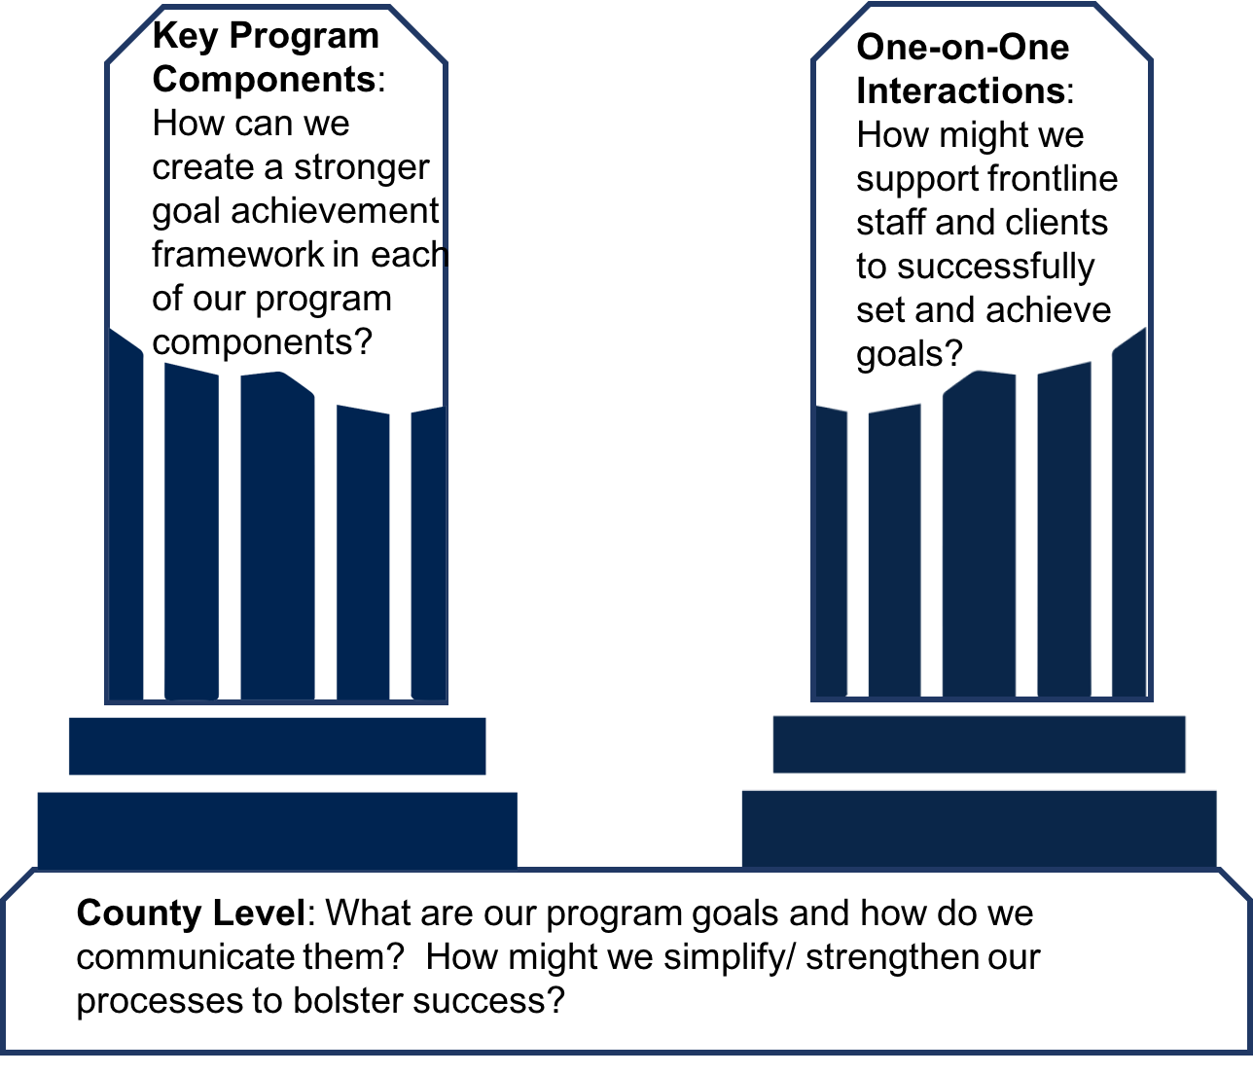
Goal Achievement at a Glance

Slide 3
Introductions:
What Helps Us to Successfully Achieve Our Goals?
Think about the last time you set a goal that you successfully achieved
Privately jot down what helped you to be successful
Introduce yourself to people at your table by sharing your goal and the factors that helped you to succeed.
Write two to three common success factors on separate sticky notes and put on the wall chart.

Slide 4
In full group, share:
What Helps Us to Successfully
Achieve Our Goals?

Slide 5
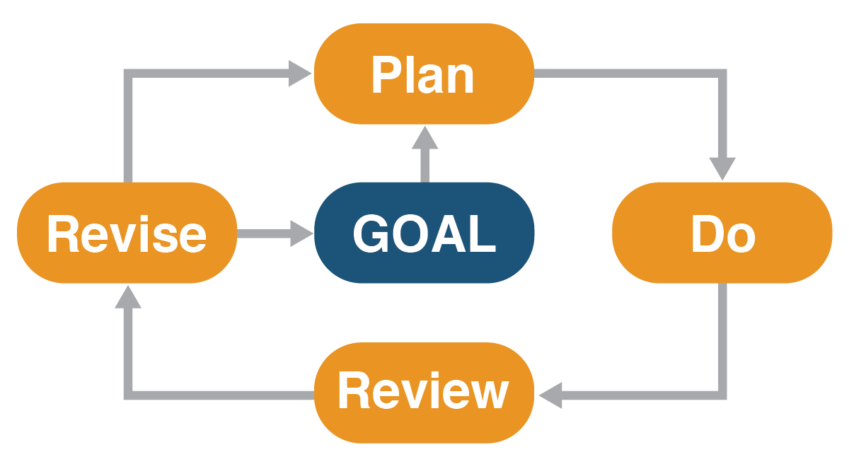
A Structured Approach to Goal Achievement: Goal, Plan, Do, Review and Revise
Goal: Set a goal – something you want to accomplish
Plan: Develop a plan for how to get from here to there
Do: Do the plan – Put it into action
Review: Review and assess your progress
Revise: Take the next action steps, make a new plan, or set a new goal

Slide 6
A Structured Approach to Goal Achievement: Goal, Plan, Do, Review and Revise
On page 4 of your packet, use the far left column to list the main, routine tasks that you do in your role.
As the day progresses, we’ll come back to this and reflect on ways that the GPDRR framework does (and could) integrate into these routine tasks.

Slide 7
What Success Looks Like

Slide 8
Three Key Adult Learning Principles
www.globallearningpartners.com
Relevance
You care about this topic or task because it relates to your life/ work now.
Engagement
You are actively involved in the learning.
Immediacy
You don’t just hear about a concept – you apply it and make meaning of it for yourself.

Slide 10
The Science Underlying the Goal Achievement Framework
Scarcity of Resources and Time (from Behavioral Science) – we have limited “bandwidth” which means we can only act on a limited amount of information at any given time
Goal Achievement – how we set goals, develop and execute plans to achieve them matters
Adult learning – in order to learn something new, we need to do something with it – providing information is not sufficient
Adult Capabilities – executive function and self-regulation; skills that support our ability to focus, plan for and achieve goals, adapt to changing situations, and resist impulsive behaviors. https://developingchild.harvard.edu/science/deep-dives/adult-capabilities/

Slide 11
What Are Adult Capabilities? (aka, Executive Function and Self-Regulation Skills)
Planning
Self-Control
Monitoring
Core adult capabilities support our ability to focus, plan for and achieve goals, adapt to changing situations, and resist impulsive behaviors. We need these skills to manage life, work, and relationships successfully.

Slide 12
12 Executive (Function) Skills
Goal-Directed Persistence
Working Memory
Flexibility
Metacognition
Planning & Prioritization
Organization
Time Management
Task Initiation
Response Inhibition
Emotional Control
Sustained Attention
Stress Tolerance

Slide 13
What do you see as your strengths? (star them)
What do you see as your weaker skills? (underline them)
12 Executive (Function) Skills
Goal-Directed Persistence
Working Memory
Flexibility
Metacognition
Planning & Prioritization
Organization
Time Management
Task Initiation
Response Inhibition
Emotional Control
Sustained Attention
Stress Tolerance

Slide 14
At your table,
Discuss the examples and discuss which Executive Skill deficit or strength they represent

Slide 15
The Relationship Between Executive Skills and Goal Achievement
 | Executive Skills
Goal | Metacognition, working memory
Plan | Planning/prioritization, time management, working memory
Do | Task initiation, response inhibition, time management, sustained attention, working memory, flexibility, organization, persistence, stress tolerance, emotional control
Review | Metacognition, working memory
Revise | Flexibility

Slide 16
Why Scarcity Matters in Our Work
Living in poverty means living in chronic scarcity
Living under the conditions of scarcity imposes a “bandwidth tax” which reduces the cognitive resources that individuals have available to devote to activities aimed at achieving long-term goals
Researchers that have studied scarcity liken living in poverty to living perpetually on a missed night of sleep
The impact of the bandwidth tax (and living on a missed night of sleep):
Reduces capacity to think logically and analyze and solve novel problems and process information
Diminishes ability to evaluate options and make high-quality decisions
Impairs self-control, often leading to impulsivity

Slide 17
Activity: What It Means to Live Under Conditions of Scarcity
How do you see the conditions of scarcity impacting participants’ and staffs’ lives?
What ideas do you have about things you already do or could do to reduce scarcity or its the impact?

Slide 18
Key Hallmarks of Goal, Plan, Do, Review and Revise
Create and Support Responsive Relationships
Start with the future, not the past: What are your hopes and dreams? What can we do to help you achieve them?
Participant is in control: what matters to them; what they want to achieve
Staff facilitate the goal achievement process – provide guidance, not solutions
Support continues when participants are putting plans into action; encourage teamwork
Strengthen Core Life Skills
Embed common goal achievement processes and language across all program components
Model goal achievement processes whenever possible
Provide guidance to help participants break tasks down into small steps
Help participants develop and write down detailed action plans
Help participants to identify and develop solutions to obstacles before they occur in the context of what they want to achieve
Reduce Sources of Stress
Provide resources to help participants meet their basic needs
Set realistic expectations
Create an organizational culture that supports workers to do their job differently, reduces program complexity and smooths the path to success whenever possible

Slide 19
Application: How Is This Similar or Different?
How is this approach similar to what you do now?
How is it different?
Over Lunch:
Where do you see opportunities for strengthening or enhancing your approach to goal achievement?
What are the biggest challenges?

Slide 21
Activity: Modeling Goal, Plan and Do
Use the checklist in your packet as you watch and listen to a role play of Goal, Plan, and Do components of GPDRR
What stood out for you as different from what you usually do?
What constraints would you need to overcome to use this approach?

Slide 22
Plan: Creating a Roadmap for Change
Break big goals down into small, manageable steps and identify resources needed to achieve them (backward mapping)
Develop specific and targeted action plans (include what, when, where, why and how)
Identify obstacles and strategies for responding to them before they occur

Slide 24
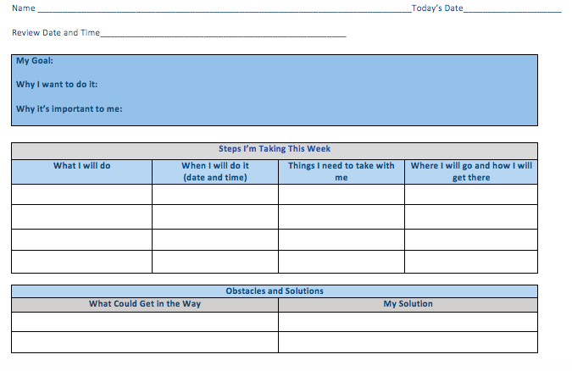

Slide 25
Backward Mapping Common Tasks
Wash a Car
Pick up a Prescription
Make Dinner
Go Grocery Shopping
Pick the Kids Up from School
Doing the Laundry

Slide 26
Supporting People as They “Do” Their Plans
Remember what needs to get done (and when)
Get started and stick with it ‘til it’s done
Manage time and stay organized
Manage stress along the way
Avoid distraction and competing demands
Other….

Slide 27
Supporting People as They “Do” Their Plans
Review ”Tips to Help Participants Successfully ‘Do’ Their Plans” to spark your thinking.
Consider the common tasks you just mapped at your tables.
What are three strategies you believe would be helpful to support this person to successfully “do” their plan?
Focus on strategies that would really and truly support success.

Slide 28
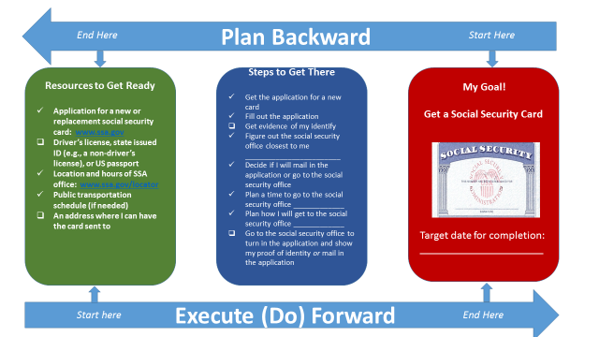
Example of Backward Mapping

Slide 29
Review and Revise: Stepping Back, Moving Forward
We rarely get goals or plans right on the first try
Opportunity to create an ongoing learning opportunity and build skills
Review
Strengths-based: What went well?
Forward-looking: What didn’t go as planned? What got in the way?
Learning: What did you learn about yourself? Well-designed goal-setting and planning processes increase the chances of successful execution
Revise
Updated action steps
New plan
New goal

Slide 31
Provide Honest Feedback
What did you learn?
What worked?
What didn’t work?
What would you like more of?
What would you like less of?
If we adapt this workshop package for counties to use on their own over time, what should we keep in mind?

Slide 32
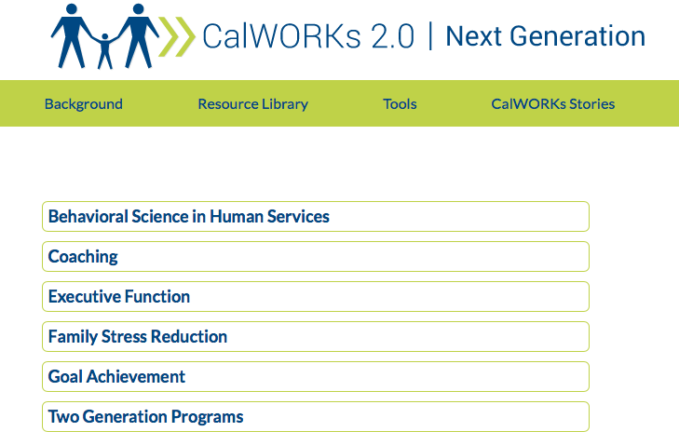
For More Information:
CalWORKs 2.0: Next Generation Website
www.CalWorksNextGen.Org

Slide 33
For More Information:
CalWorks 2.0 Implementation Team
LaDonna Pavetti pavetti@cbpp.org
Valerie Uccellani Valerie@globallearningpartners.com
Megan Stanley Meganatroy@gmail.com
Natasha Nicolai Nnicolai@mathematica-mpr.com
Jackie Crowley jcrowley@mathematica-mpr.com
Rachel Nicolosi Rachel@globallearningpartners.com

